Slide 1
DIGITAL DESIGN AND COMPUTER ARCHITECTURE
DESIGN AND SIMULATION OF A MULTI-BIT BINARY ADDER AND SUBTRACTOR
PRESENTED BY:
Nikhil Srivatsa(2620090029)
Sri Vishwa Chaitanya(2620090032)
Vinod Kumar(2620090068)
Jashwanth Poorna Sai(2620090097)

Slide 2
DESIGN AND SIMULATION OF A MULTI-BIT BINARY ADDER AND SUBTRACTOR
A multi-bit binary adder–subtractor is a combinational circuit that can perform both addition and subtraction of binary numbers using the same hardware, controlled by a single input signal. It is widely used in Arithmetic Logic Units (ALUs) of processors.

Slide 3
ADDER AND SUBTRACTOR
Binary Adder
Definition: A circuit that adds two binary numbers.
Types:
  Half Adder: Adds two 1-bit inputs → outputs Sum & Carry.
  Full Adder: Adds three inputs (two bits + carry-in) → outputs Sum & Carry-out.
Multi-bit Addition: Achieved by connecting several full adders in series (Ripple-Carry Adder).
Binary Subtractor
Definition: A circuit that subtracts one binary number from another.
Method: Subtraction is performed using two’s complement:
  Invert the bits of the subtrahend.
  Add 1 to form two’s complement.
  Add it to the minuend using a binary adder.

Slide 4
Adder-Subtractor Combined Circuit
Control Signal (K):
  K = 0 → Addition
  K = 1 → Subtraction
Working:
  Each bit of operand B is XOR with K.
  Carry-in of the least significant full adder is set to K.
  This ensures addition when K=0 and subtraction when K=1.
Outputs:
  Sum/Difference bits
  Carry/Borrow bits

Slide 5
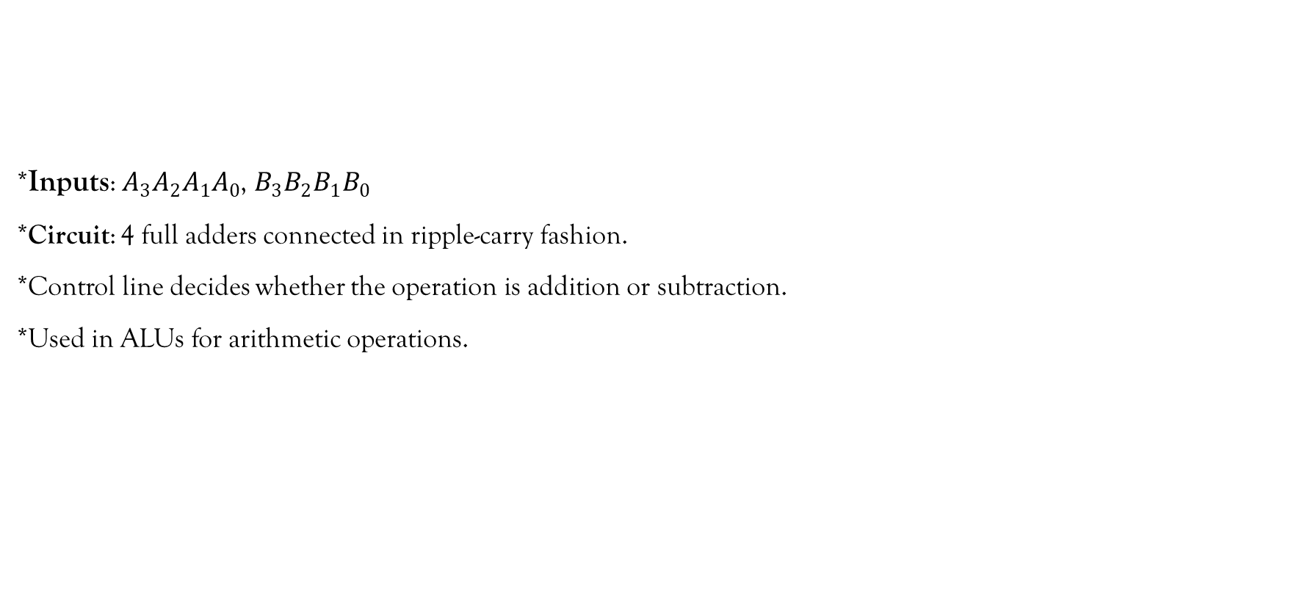
Example: 4-bit Adder-Subtractor
*Inputs: $A_{3}A_{2}A_{1}A_{0}$, $B_{3}B_{2}B_{1}B_{0}$
*Circuit: 4 full adders connected in ripple-carry fashion.
*Control line decides whether the operation is addition or subtraction.
*Used in ALUs for arithmetic operations.

Slide 6
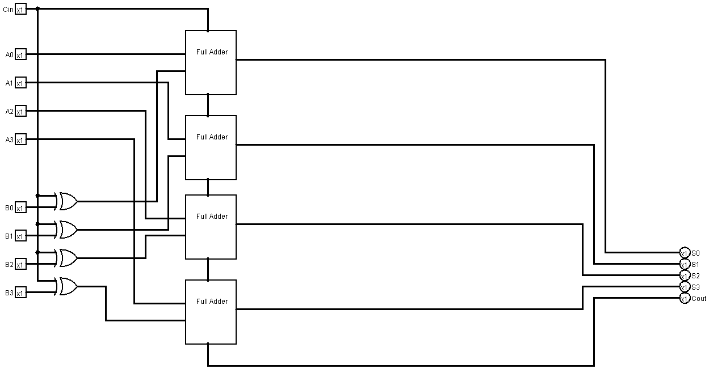
4 BIT ADDER-SUBTRACTOR

Slide 7
Truth Table for 4-Bit Adder–Subtractor
Control (K) | Operation | A (4-bit) | B (4-bit) | Result (S₃S₂S₁S₀) | Carry/Borrow (Cout)
0 | Addition | 0001 | 0010 | 0011 | 0
0 | Addition | 0101 | 0011 | 1000 | 0
0 | Addition | 1111 | 0001 | 0000 | 1
1 | Subtraction | 0101 | 0011 | 0010 | 0
1 | Subtraction | 1000 | 0011 | 0101 | 0
1 | Subtraction | 0001 | 0010 | 1111 | 1

Slide 8
GITHUB REPOSITORY
https://github.com/srivishwachaitanya/-KLH-FED-2026-Section-No-14--Batch-no-16

Slide 9
THANK YOU

